Slide 1
Partition Detection in Byzantine Networks
Yerom-David Bromberg, Manon Sourisseau, François Taïani, (Univ Rennes, Inria, CNRS, IRISA, France), Jeremie Decouchant (TU Delft, The Netherlands)
IEEE ICDCS 2024, New Jersey, USA

Slide 2
Roadmap
Background
The Byzantine Generals Problem
The CAP Theorem
Motivation
Challenges
Related Works
Partition Detection in Non-Byzantine Settings
Byzantine-Resilient Communication
Vertex Connectivity and Byzantine Detection
Problem Statement
NECTAR Algorithm
Overview
NECTAR Properties
NECTAR: Explaination
Evaluation Results
Experimental Setup
Compared Against
NECTAR Advantages
Performance vs. Accuracy
Conclusion

Slide 3






Background: The Byzantine Generals Problem
Commanders is honest
Introduced by Lamport, Shostak, and Pease (1982).
Challenges consensus in distributed systems with some nodes behaving maliciously or unpredictably (Byzantine faults).
Core Challenge: Getting all loyal nodes to agree, despite traitors sending false or conflicting messages.
Models the worst-case failure scenario in distributed systems.
Conditions for Solving It: Requires n ≥ 3t + 1 nodes to tolerate t Byzantine faults in a fully connected network.
Consensus is reached

Slide 4
Background: The Byzantine Generals Problem
Commanders is faulty
2
1
Faulty node (f) = 3
Total nodes (n) = 3f + 1 = 10
How can we detect partitions in a Byzantine network without knowing the topology or network?
Consensus is reached

Slide 5


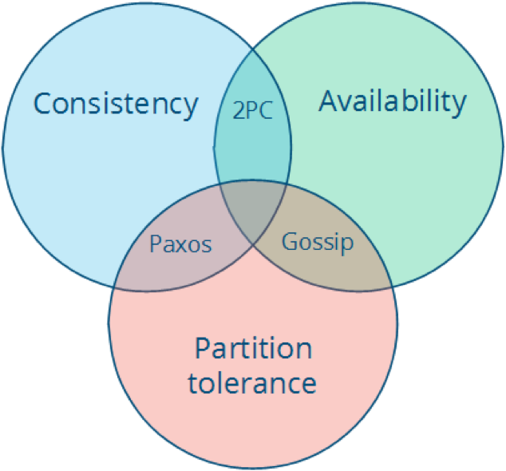


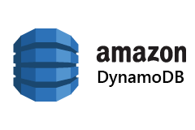

Background: The CAP Theorem
Proposed by Eric Brewer (2000); formalized by Gilbert & Lynch (2002).
In distributed systems, only two of three can be fully guaranteed:
Consistency (same data),
Availability (request=response),
Partition Tolerance(continues)
NECTAR detects partitions under Byzantine faults, supporting the Partition Tolerance aspect of CAP.
Note: Accurate partition detection helps systems adapt dynamically to maintain correctness.
Protocol | Goal | Centralized? | Use Case
P2PC | Atomic commit | Yes | DB transactions
Gossip | Info spread | No | Peer sync, failure detection
Paxos | Consensus | Quorum-based | Distributed coordination

Slide 6
Motivation
Network partitions cause data loss and inconsistency, e.g., CAP theorem.
Existing detection methods:
Assume all nodes are correct or may crash.
Ignore Byzantine behaviors.
Byzantine-resilient protocols require a connected network.
Need for detecting partitionability under Byzantine faults.

Slide 7
Challenges
Unknown Topology: Nodes don’t know the full graph.
False Trust: Byzantine nodes may behave correctly during detection.
Communication Masking: Byzantine nodes can drop or delay messages.
Impossibility in Asynchronous Systems: Messages delayed ≈ partitions.

Slide 8
Related Works (1/3) – Partition Detection in Non-Byzantine Settings
Fault-Free Models
MindTheGap (MtG)—Bouget et al., SRDS 2018:
A lightweight, fully decentralized algorithm for Mobile Ad Hoc Networks (MANETs)
Nodes gossip Bloom filters representing reachable peers.
Achieves ~90% accuracy under 40% message loss.
Ritter et al., SECON 2004:
Beacon-based partition detection in MANETs.
Relies on identifying stable “border” nodes.
Not suitable under node failures or adversarial behavior.
Crash-Tolerant Models
van Renesse et al., 1998:
Gossip-based failure detection extended for partition detection.
Probabilistic assumptions with acceptable false positive rates.
Still fails under malicious interference.
Conan et al., NCA 2008:
Use of heartbeat vectors and reachability graphs
Attempt to differentiate disconnection vs. crash.
Tailored for mobile networks, it assumes benign behavior.
Note: None of these can handle arbitrary (Byzantine) behavior—e.g., lying about connections, selective message dropping, or signature forgery.

Slide 9
Related Works (2/3) – Byzantine-Resilient Communication
Classical Byzantine Protocols
Dolev (1981) & Bracha (1987):
Reliable broadcast in arbitrary graphs.
Requires k ≥ 2t + 1 connectivity to tolerate t Byzantine faults.
Byzantine consensus in fully connected networks.
Requires n ≥ 3t + 1.
Message complexity: O(n!), It is impractical for large systems.
Dolev & Strong (1983):
Introduced signature chains to tolerate Byzantine actors.
Inspired NECTAR’s chain of trust propagation.
Practical Enhancements
Bonomi et al., ICDCS 2021:
Optimized Dolev+Bracha for partially connected networks.
Reduced latency and communication overhead.
Focused on broadcast, not partition detection.
Khan et al., PODC 2019:
Byzantine consensus under local broadcast model (e.g., wireless).
Relaxed requirements: 3t/2 < k and 2t < d (degree).
Relevant to NECTAR in wireless IoT/drone settings.
Note: Byzantine-resilient protocols exist but either assume full connectivity or are computationally expensive for detection-specific tasks.

Slide 10
Related Works (3/3) – Vertex Connectivity and Byzantine Detection
Vertex Connectivity in Non-Byzantine Settings
DECK Algorithm (Akram & Dagdeviren, 2018):
Distributed method to compute k-connectivity.
Asynchronous, reliable networks only.
Doesn’t tolerate Byzantine interference.
Piergiovanni & Baldoni, LADC 2007:
Introduced eventual connectivity in dynamic networks.
Good for churn, but assumes correct behavior.
Connectivity Detection in Byzantine Graphs
Augustine et al., 2022 (Congested Clique model):
Only existing work on Byzantine connectivity testing.
Detects if the graph has ≥ 2t + 1 components.
Assumes fully connected networks (congested clique), not arbitrary graphs.
3
critical point
7
2
4
6
8
5
9
1
10
NECTAR detects partitions in arbitrary networks under Byzantine threats without needing full topology knowledge or trusted nodes.

Slide 11
Problem Statement
Goal: Identify whether a network is partitionable under up to t Byzantine nodes.
Detection Algorithm Output:
NOT PARTITIONABLE: Safe from Byzantine-caused partition.
PARTITIONABLE: There exists a configuration where Byzantines can cause partition.
Correctness Criteria:
Agreement, Safety, Termination, Sensitivity (≥ 2t).
To understand the problem, we first need to understand t-Byzantine partitionability and vertex connectivity κ(G).

Slide 12
t-Byzantine Partitionability — Definition & Theorem
t-Byzantine Partitionability: A graph G = (V, E) is t-Byzantine partitionable if there exists an execution of any algorithm A on G, with at most t Byzantine nodes, such that at least one pair of correct nodes cannot exchange messages.
Theorem 1: G is t-Byzantine partitionable if and only if there exists a subset V_{b}⊆ V with ∣V_{b}∣ ≤ t such that the induced subgraph G[V∖V_{b}] is disconnected.
3
7
2
4
6
8
5
9
1
10
V_{b1}= {4, 5} , V_{b1} ⊆ V and |V _{b1}| ≤ t ⇨ 3-BP
V_{b2}= {5, 6}, V_{b2} ⊆ V and |V_{b2}| ≤ t ⇨ 3-BP
V_{b3}= {4, 5, 6}, V_{b1} ⊆ V and |V_{b3}| ≤ t ⇨ 3-BP

Slide 13
Vertex Connectivity & Corollary
Vertex Connectivity κ(G): The minimum number of vertices whose removal disconnects the graph.
Corollary 1: A graph G is t-Byzantine partitionable iff κ(G) ≤ t
Interpretation:
If κ(G) > t, no set of t Byzantine nodes can partition G.
If κ(G) ≤ t, some placement of t Byzantine nodes can partition G.
Design Insight: To tolerate t Byzantine faults, a network must satisfy κ(G) > t.
3
7
2
4
6
8
5
9
1
10
κ(G) = 2 | {4, 5} or {5, 6}
We can refer to them as 2-Byzantine Partitionable (2-BP), 3-BP, and so on.

Slide 14
Problem Statement
Goal: Identify whether a network is partitionable under up to t Byzantine nodes.
Detection Algorithm Output:
NOT PARTITIONABLE (κ(G) > t): Safe from Byzantine-caused partition.
PARTITIONABLE (κ(G) ≤ t): There exists a configuration where Byzantines can cause partition.
Correctness Criteria:
Agreement, Safety, Termination, Sensitivity (≥ 2t).
Termination: All correct nodes finish deciding in bounded time (guarantees liveness).
Agreement: All correct nodes reach the same conclusion (ensures consistency, even with Byzantine interference).
Safety: If the Byzantine nodes actually form a vertex cut in the graph (i.e., they can disconnect correct nodes), then:
No correct node says NOT PARTITIONABLE.
This avoids false negatives (i.e., missing a real partition).
Sensitivity (when k₀ ≥ 2t): The network is not t-Byzantine partitionable at the level of correct nodes. Even though nodes do not know the full network topology, correct nodes remain connected.
The NECTAR algorithm is introduced to address this problem.

Slide 15
NECTAR: Neighbors Exploring Connections Toward Adversary Resilience.
Algorithm Overview
Uses digital signatures in chain for authentication.
Spreads neighbor info in n−1 synchronous rounds.
Nodes compute:
Reachability
Vertex connectivity (k)
Partition status: if k ≤ t → PARTITIONABLE
3
7
2
4
6
8
Msg₁
5
Msg₅
9
1
Msg₁₀
10
Node1:
1. m₁ = {2, 4, 5}
2. sig₁ = sign(H(m₁), sk₁)
3. Msg₁ = (m₁, sig₁ )
Node10:
1. Verify(H(m₁), sig₁, pk₁) == 1
2. Verify(H(m₁||sig₁), sig₅, pk₅) == 1
3. sig₁₀ = sign(H(m₁||sig₁||sig₅), sk₁₀)
4. Msg₁₀ = (m₁, sig₁, sig₅, sig₁₀)
Node9:
1. Verify(H(m₁), sig₁, pk₁) == 1
2. Verify(H(m₁||sig₁), sig₅, pk₅) == 1
3. Verify(H(m₁||sig₁||sig₅), sig₁₀, pk₁₀) == 1
Node5:
1. Verify(H(m₁), sig₁, pk₁) == 1
2. sig₅ = sign(H(m₁||sig₁), sk₅)
3. Msg₅ = (m₁, sig₁, sig₅)

Slide 16
NECTAR: Neighbors Exploring Connections Toward Adversary Resilience.
NECTAR Properties
Byzantine Resilience:
Cannot forge neighborhood proofs.
Cannot fake paths between correct nodes.
k₀-Sensitivity: k₀ ≥ 2t ⇒ NOT PARTITIONABLE.
Agreement, Safety, Termination.
Vertex-Disjoint Paths: paths with no shared intermediate node.
x
A
Y
B
Z
Suppose k₀ = 1, t = 1:
Paths:
A → Y → B
If Y is faulty, A can not communicate with B.
if Byzantine node (t) = 1:
k₀ = 3
k₀ ≥ 2t ⇒ NOT PARTITIONABLE
A and B still communicate via X and Z.

Slide 17
NECTAR: Explaination
NECTAR Algorithm Phases:
Initialization:
Edge Propagation Phase (Rounds 1 to n−1):
Decision Phase:
⇒ To simplify the understanding of NECTAR, we walk through a step-by-step dry run on a small example network.
Example: We’ll use a simple graph of 8 nodes (n = 8) with a fault threshold t = 2. Vertex connectivity k = 3
1
2
3
4
5
6
7
8
Locally-generated proofs of the neighborhood: G_{i⁣} [i, neighbor] = proof_{i, neighbor}

Slide 18
NECTAR: Neighbors Exploring Connections Toward Adversary Resilience.
Initialization (Local View):
Each correct node builds a local graph matrix Gᵢ, e.g. for node1:
Starts with:
G₁[1, 2] = proof_{1, 2}
G₁[1, 4] = proof_{1, 4}
node1 knows it has edges to node2 and node4.
It will send these edges to neighbors in the next round.
1
2
3
4
5
6
7
8

Slide 19
NECTAR: Neighbors Exploring Connections Toward Adversary Resilience.
Edge Propagation Rounds (R = 1 to n-1 = 7):
node1 send {(1, 2), proof_{1, 2}} and {(1, 4), proof_{1, 4}}
node2 and node4 respond with:
node2 → (node1, node3, node5)
node4 → (node1, node5, node7)
node5, node7, and others start receiving forwarded edges from node2, node4, etc.
Each node:
Appends the signature chain to forwarded edges
Accepts only valid chains of length ≤ R
Rejects delayed or malformed messages
After 7 rounds, all correct nodes receive every edge reachable via paths that don’t involve t Byzantine nodes cutting them off.
1
2
3
4
5
6
7
8

Slide 20
NECTAR: Neighbors Exploring Connections Toward Adversary Resilience.
Decision Phase
Each correct node builds a global graph G₁′​ from all valid edge proofs it receives.
This includes edges from correct nodes & faulty nodes.
node1 checks:
Can it reach every other node through G₁'?
It can reach node(2, 4, 5, 7, 8).
node3/node6 might lie, but do not prevent connectivity among correct nodes
Compute Vertex Connectivity (k) from global graph G₁′​.
1
2
3
4
5
6
7
8
k₀-Sensitivity: k₀ ≥ 2t
if k > t and R = n then
confirmed = False
decide(NOT PARTITIONABLE)
else
if R = n then
confirmed = False
else
confirmed = True
decide(PARTITIONABLE)
3
k = 3, t = 2
7
2
6
8
4
5
9
1
10

Slide 21
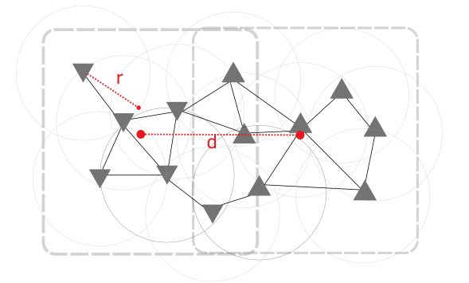
Evaluation Results: Experimental Setup
Implementation: Algorithms coded in C++ using Salticidae networking library.
Cryptography: ECDSA signature scheme used for Byzantine resilience.
Hardware: Experiments run on a powerful server (Intel Xeon Gold, 188GB RAM).
Execution: Each simulated "node" (drone) ran as an isolated Docker container.
Topologies: Evaluated on realistic connectivity-dependent graphs and a drone network scenario.
An example of our drone scenario with random graph. Two scatters of points are generated. d is the distance between the barycenters of the scatters, and r is the communication scope.

Slide 22
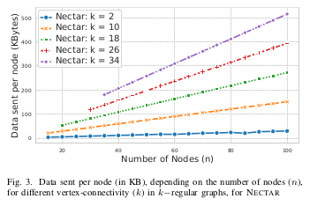
Evaluation Results: Network Cost vs. Connectivity
Evaluated NECTAR on k-regular graphs with varying connectivity
Network cost per node grows with connectivity and number of nodes
Max observed: ~500 KB per node (n = 100, k = 34)
Less costly in other topologies (2× less in k-diamond, 2.5× in wheel graphs)

Slide 23
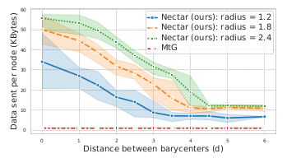
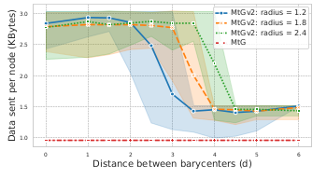
Evaluation Results: Network Cost in Drone Topologies
Varying distances (d) between node clusters and communication radii.
NECTAR cost: from ~50 KB to ~60 KB depending on radius and partition.
MtG cost: constant ~1.9 KB (low but unreliable)
MtGv2: up to ~3 KB (improved but still less robust than NECTAR)

Slide 24
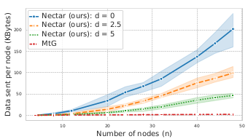
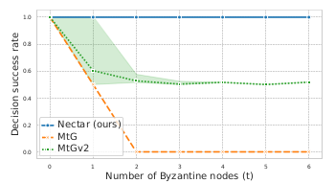
Evaluation Results: Scalability with Node Count
NECTAR cost grows with node count and density (up to ~200 KB @ n = 50). This is presented as a drawback of NECTAR.
MtGv2 remains lightweight (~7.5 KB max), but loses accuracy under Byzantine faults
NECTAR is still practical for 100-node networks despite higher cost

Slide 25
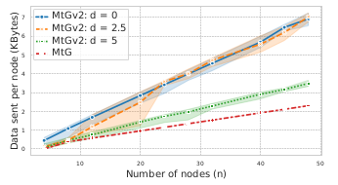
Evaluation Results: Byzantine Resilience
NECTAR maintains 100% accuracy under Byzantine attacks (up to 6 malicious nodes)
MtG fails with even 1–2 Byzantine nodes (0% success)
MtGv2 better, but inconsistent: success rate drops to 30% on some topologies
NECTAR is the only method to consistently meet safety & agreement requirements

Slide 26
Evaluation Results: Comparison: NECTAR vs MtG vs MtGv2
Feature | NECTAR | MtG | MtGv2
Byzantine Resilience | Strong — Tolerates up to t Byzantine nodes (k ≥ 2t), maintains 100% accuracy | None — Easily corrupted by even 1 Byzantine node | Partial — Signatures help, but still vulnerable to misbehavior
Decision Agreement (Correct Nodes) | Guaranteed — All correct nodes reach the same conclusion | Broken — Byzantine nodes can cause disagreement | Unreliable — Disagreement possible with just 1 Byzantine node
Scalability (Data Sent per Node) | Moderate — Up to 500 KB per node (worst-case @ 100 nodes) | Excellent — ~2 KB per node | Good — ~7.5 KB per node in dense graphs
Message Complexity (Worst Case) | O(n⁴) | O(n·log(n)) approx. | O(n²)

Slide 27
This paper benefits the lab by providing a robust solution to detect unsafe connectivity in distributed and wireless systems, ensuring reliable operation even with malicious participants.

Slide 28
Feedback and Query

Slide 29
thank you

